Slide 1
House Prices in King County, USA
Exploring Predictors Using Regression Modeling and Diagnostics Richel Charntel Jing Jing

Slide 2
Slide 1: Introduction and Objective
Objective: Explore and quantify the key factors influencing house prices in King County, WA.
Dataset: Kaggle’s King County housing dataset containing 21,613 observations of real estate transactions.
Focus: Investigate the relationships between house price and predictors such as:
Continuous variables: sqft_living, bedrooms, bathrooms.
Categorical variables: waterfront, grade.

Slide 3
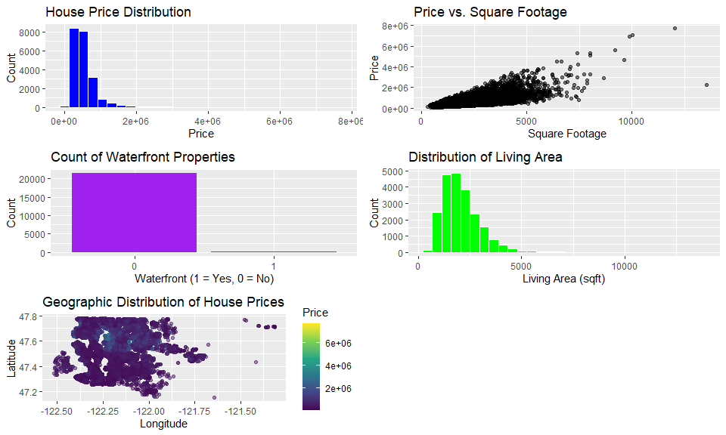
Slide 2: Exploratory Data Analysis (EDA)
Key Insights:
House Price Distribution: Right-skewed, with most properties priced below $500,000.
Price vs. Square Footage: Positive correlation with variability due to other factors.
Waterfront Properties: Most homes lack waterfront access.
Living Area: Most homes are moderate in size, though a few large properties influence the mean significantly.
Geographic Location: Higher-priced homes are concentrated in specific areas, likely reflecting desirable neighborhoods or proximity to amenities.
Visualizations:
## Warning: package 'gridExtra' was built under R version 4.4.2
## ── Attaching core tidyverse packages ──────────────────────── tidyverse 2.0.0 ── ## ✔ dplyr 1.1.4 ✔ readr 2.1.5 ## ✔ forcats 1.0.0 ✔ stringr 1.5.1 ## ✔ lubridate 1.9.3 ✔ tibble 3.2.1 ## ✔ purrr 1.0.2 ✔ tidyr 1.3.1 ## ── Conflicts ────────────────────────────────────────── tidyverse_conflicts() ── ## ✖ dplyr::combine() masks gridExtra::combine() ## ✖ dplyr::filter() masks stats::filter() ## ✖ dplyr::lag() masks stats::lag() ## ℹ Use the conflicted package (<http://conflicted.r-lib.org/>) to force all conflicts to become errors
## Warning: package 'corrplot' was built under R version 4.4.2
## corrplot 0.95 loaded ## Loading required package: carData ## ## Attaching package: 'car' ## ## The following object is masked from 'package:dplyr': ## ## recode ## ## The following object is masked from 'package:purrr': ## ## some ## ## Loading required package: zoo ## ## Attaching package: 'zoo' ## ## The following objects are masked from 'package:base': ## ## as.Date, as.Date.numeric ## ## ## Attaching package: 'MASS' ## ## The following object is masked from 'package:dplyr': ## ## select

Slide 4
Slide 3: Model Comparison Metrics

Slide 5
Model Metrics Comparison
Model | SSE | R2 | Adj_R2 | AIC | BIC | Cp
Forward | 1090.8867 | 0.7699731 | 0.7697726 | -2097.037 | -1938.316 | -20623
Backward | 320.1836 | 0.9324854 | 0.9324199 | -27421.584 | -27246.991 | -20619
Both | 1090.8867 | 0.7699731 | 0.7697726 | -2097.037 | -1938.316 | -20623
Refined | 1109.1328 | 0.7661257 | 0.7660012 | -1768.304 | -1665.136 | -20637

Slide 6
Slide 4: Interaction Effects Table
Model | SSE | R2 | Adj_R2 | AIC | BIC | Cp
Waterfront:Condition | 320.1398 | 0.9324946 | 0.9324161 | -27416.41 | -27210.07 | -20609
Waterfront:Grade | 320.1513 | 0.9324922 | 0.9324137 | -27415.66 | -27209.33 | -20609
Bathrooms:Floors | 312.0156 | 0.9342077 | 0.9341312 | -27947.51 | -27741.18 | -20609
Sqft Living:Condition | 320.1446 | 0.9324936 | 0.9324151 | -27416.10 | -27209.76 | -20609
Interaction Effects Metrics

Slide 7
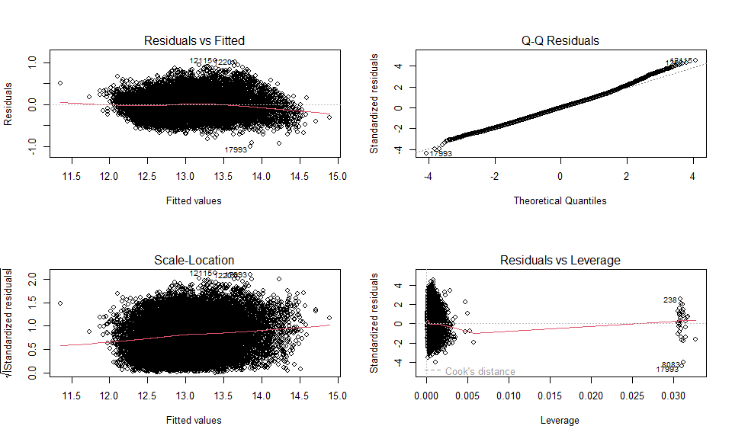
Slide 5: Diagnostics and Final Model
Diagnostics:

Slide 8
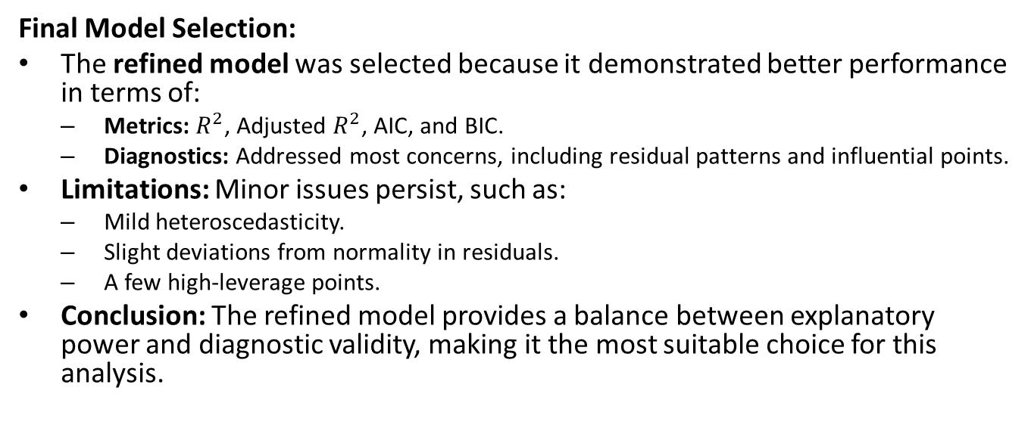
Final Model Selection:
The refined model was selected because it demonstrated better performance in terms of:
Metrics: $R^{2}$, Adjusted $R^{2}$, AIC, and BIC.
Diagnostics: Addressed most concerns, including residual patterns and influential points.
Limitations: Minor issues persist, such as:
Mild heteroscedasticity.
Slight deviations from normality in residuals.
A few high-leverage points.
Conclusion: The refined model provides a balance between explanatory power and diagnostic validity, making it the most suitable choice for this analysis.

